Slide 1
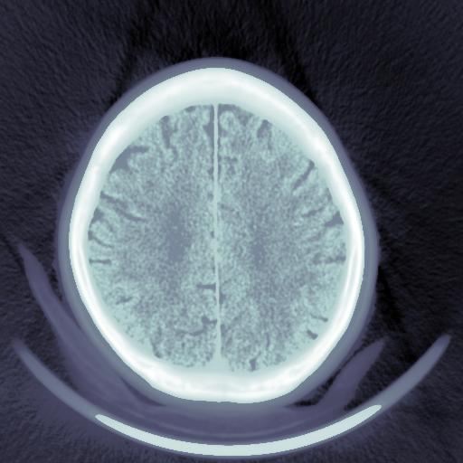
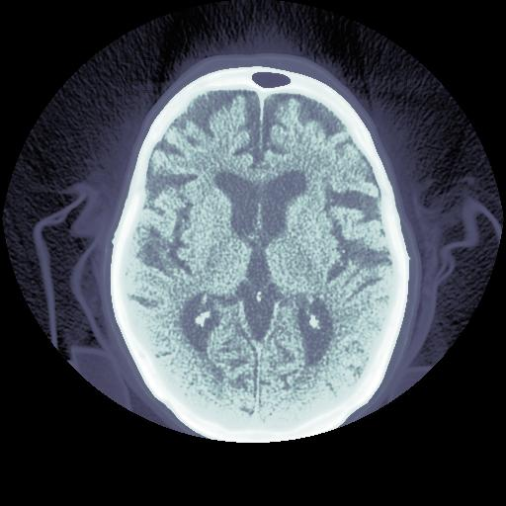
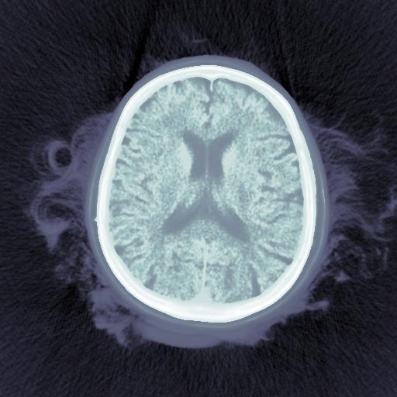
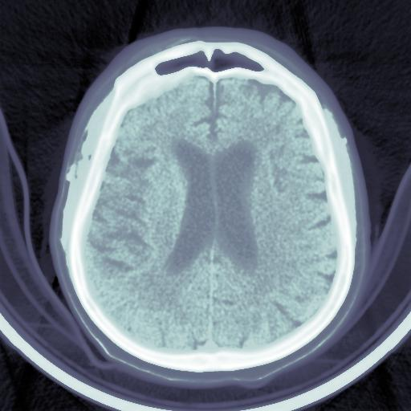
Brain Hemorrhage Classification
Joseph Kwilman, Emmanuel Manolios, Aidan Domondon, Alissa Amchentseva, Jake Wallack

Slide 2
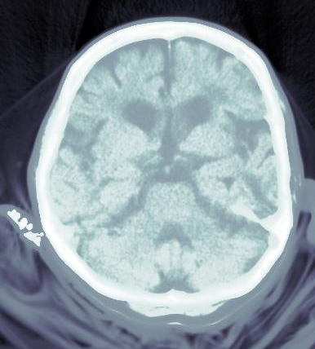
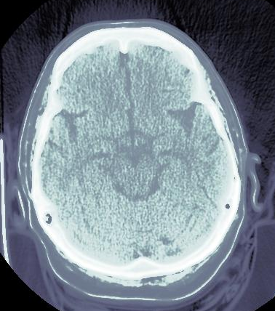
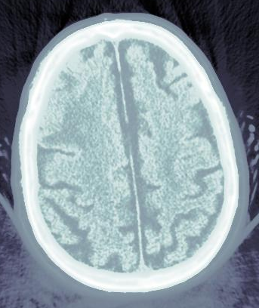
Introduction
Currently:
Manually reading CT scans for brain hemorrhages
Problems:
Availability of care
limited access to expert neuroscientists and radiologists
Costly care
Time sensitive cases
Advantages of automation:
Offload work from human experts
Widen access to care
Decrease cost of care
More time → quicker response to urgent cases
Notes:
In time-sensitive cases, reading them quickly can be a matter of life or death

Slide 3
Introduction
Goal: Develop a neural network that automatically:
Detects if a CT scan shows a hemorrhage
If there are any:
Classifies the type of hemorrhage(s)
Highlights the region on the scan where they appear
Notes:
In time-sensitive cases, reading them quickly can be a matter of life or death

Slide 4
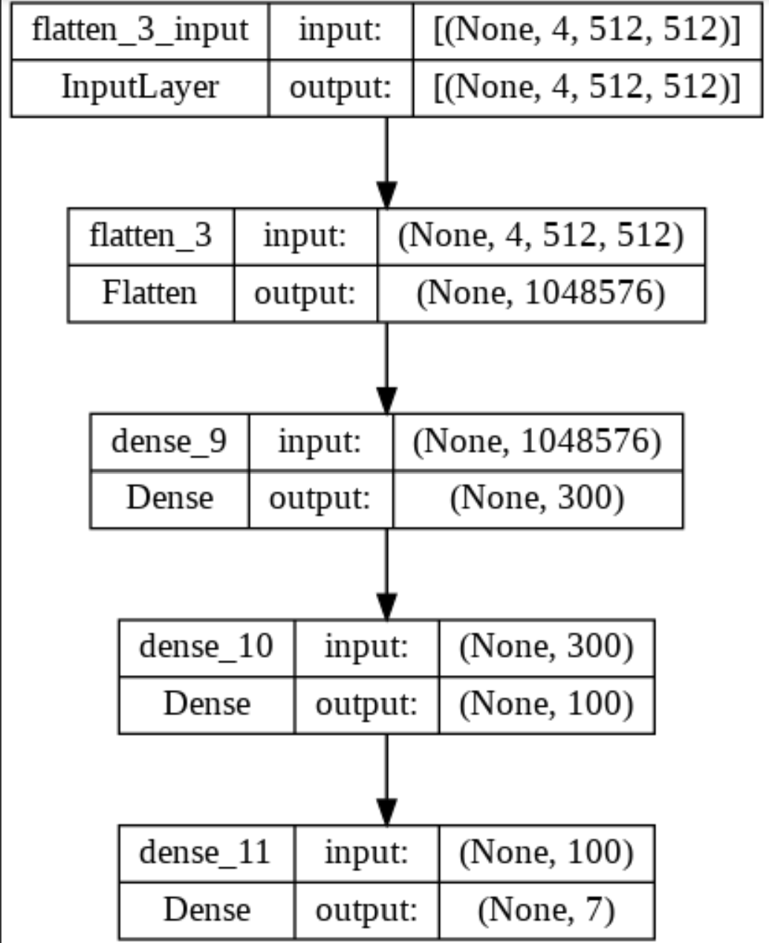
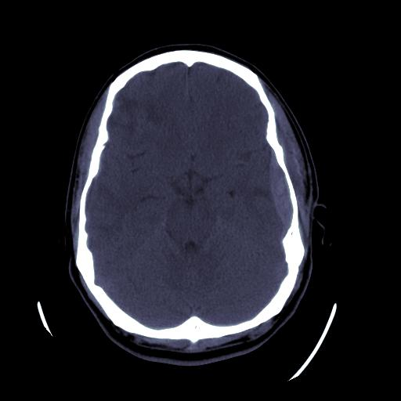
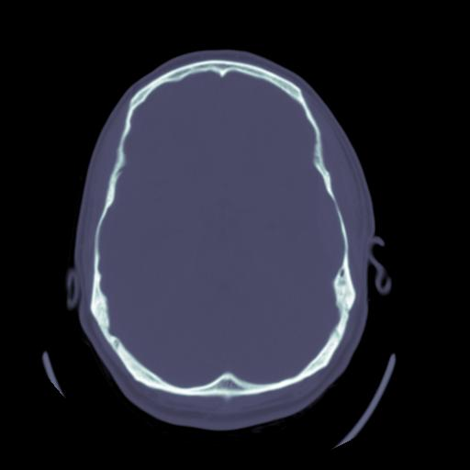
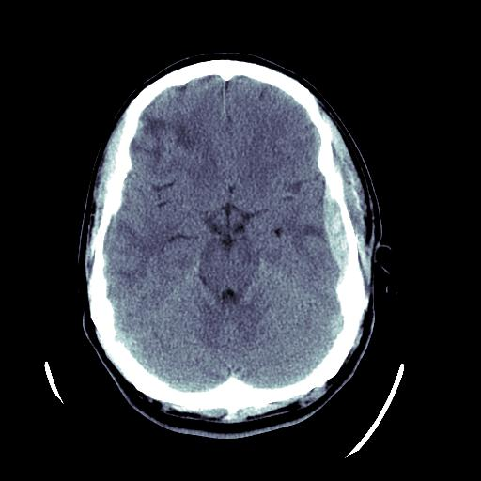
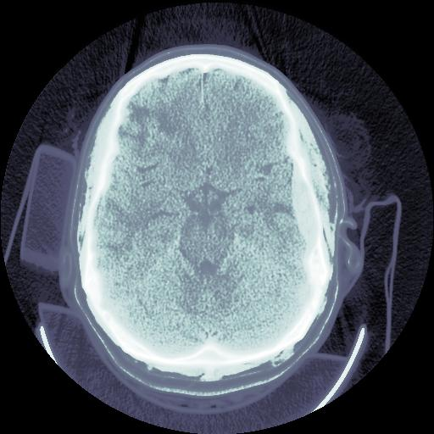
Implementation: Model 1
4 x 512 x 512
Basic Neural Network
87% Accuracy

Slide 5
Wait…
It’s only guessing “normal”
Let’s do some data cleaning!

Slide 6
Data cleaning
Four Step Process
Remove flagged images from labels
Manually sort through images (mainly “normal”) and remove images that were perceived as errors
Remove rows from labels if the images did not exist in our dataset (over 400k rows)
Remove images which were not 512 x 512

Slide 7
Downsampling
Vestibulum congue tempus
Vestibulum congue tempus
DS = 16 → 16384 Pixels
16384 Pixels → 128 x 128
262144 Pixels
Flattened version of 512 x 512 image
Tried different DS rates, 16 worked best for our models
Formed our downsampled, flattened image into a 2d array
1
1
2
3
3

Slide 8
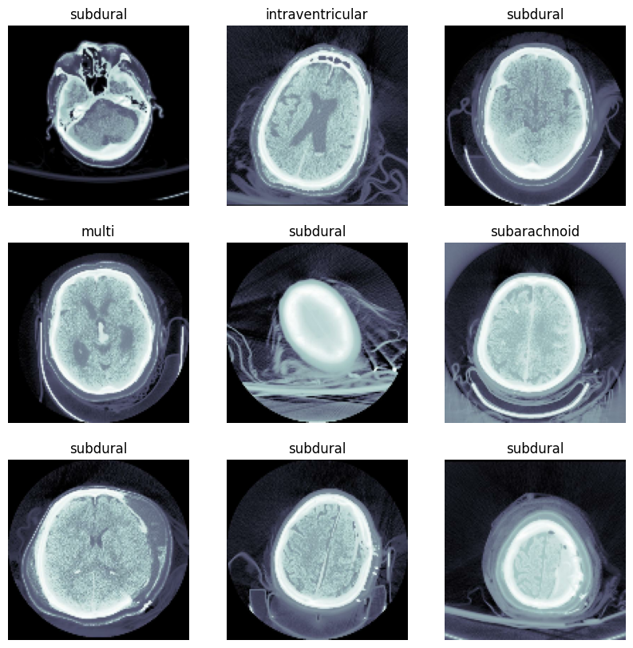
Implementation: Model 2
Tensorflow Dataset
data
epidural
intraparenchymal
intraventricular
multi
normal
subarachnoid
subdural
Batches of images
Easier Downsampling
Whole data used by model!

Slide 9
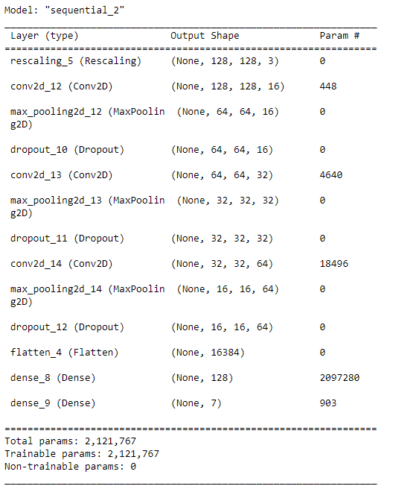
Implementation: Model 2
128x128
512x512
Downsample
“epidural”
2. 3x convolution and
Max-pooling and
Dropout
3. Flattening and condensing

Slide 10
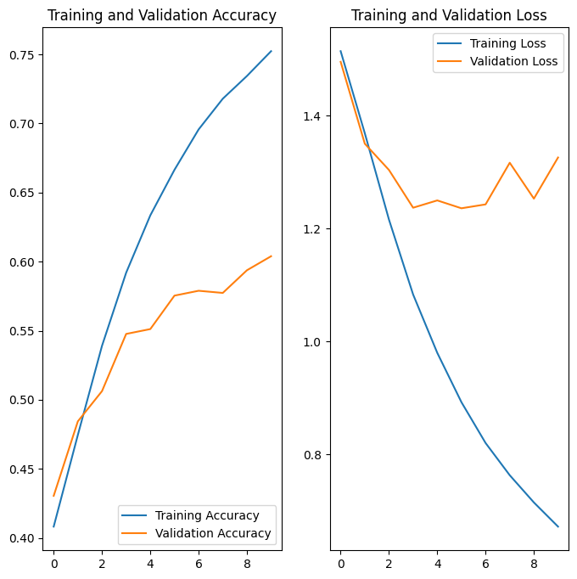
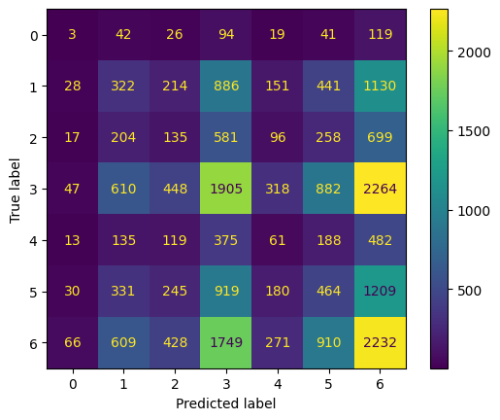
Results
Model 2’s results:
['epidural', 'intraparenchymal', 'intraventricular', 'multi', 'normal', 'subarachnoid', 'subdural']

Slide 11
Questions?

